Slide 1

WIB Firmware Development for DAT ColdADC QC
Jillian Donohue on behalf of the BNL CE group
12/19/2023
Notes:
Title: WIB Firmware Development for DAT ColdADC QC

Slide 2
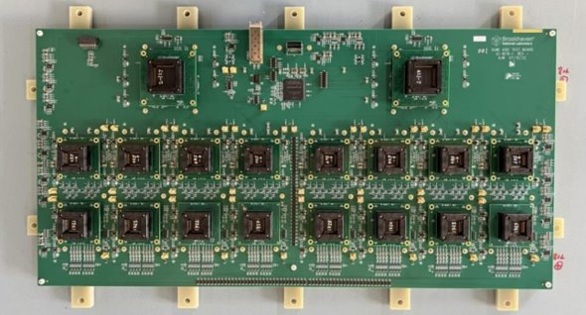
Outline
ColdADC QC requirements
Averaging firmware
Histogram firmware
Current to-do’s

Slide 3
ColdADC QC requirements
Requirements:
Sampling frequency ~2 MHz
Number of ADC bits: ≥ 12
Total power (of all ASICs): < 50 mW/channel
Noise contribution ≪ 1000 e- (negligible compared to LArASIC)
Specifications:
Crosstalk: < 1%
Differential Nonlinearity (DNL): Absolute value < 1
Integral Nonlinearity (INL): < 1(12-bit ADC unit)
Equivalent Number of Bits (ENOB) > 10.3
Overflow protection: When input signal exceeds the upper or lower ADC range, the output should be fixed at the maximum or minimum value.

Slide 4
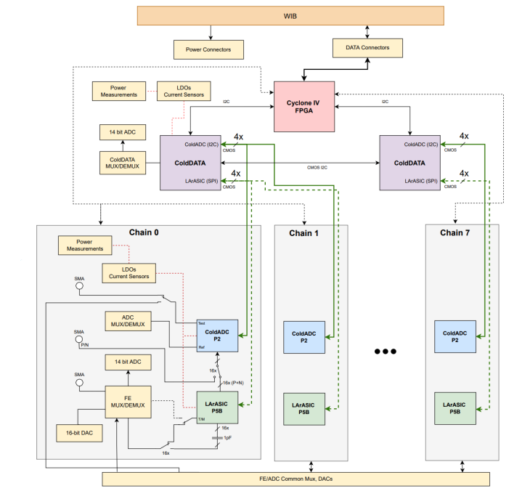
DAT overview
Tests 1 FEMB’s worth of ASICs
2 COLDATA ASICs
8 COLDADC ASICs
8 LArASICs
Appears like an FEMB to the WIB
Monitors all ASIC power
Tests all ASIC analog & digital IO
Notes:
Just as a reminder

Slide 5
ColdADC QC Procedure and Test Items based on DAT
Chip Placement
(manual or Robot)
Record input info
Input info: Date, Time, Location, Tester, DAT SN, Socket SN, Chip ID, and etc.
Placement checkout
(<1 min)
Basic functionality checkout to assure any chip is aligned in the socket, no short, no open pin
N
Power cycle at least 5 times with different configs
PASS?
Test I2C communication (Write/read registers)
Check power-on reset (verify default register values)
Y
Measure reference voltages
QC testing (RT & LN2)
Measure ring oscillator frequency
Verified doable on DAT
Perform auto calibration; check weights
Measure open channel noise (new DAT)
Measure DNL/INL (slow ramp or sine wave input)
Check overflow protection
Measure ENOB (optional, performance to be evaluated)
Crosstalk (optional, performance to be evaluated)

Slide 6
Averager
Informs us on the ColdADC’s DC offset, input range, gain, DC noise, & overflow protection
Inject a known DC voltage via an external DAC into the ColdADC channels to see what code it outputs
Need to take an average because noise will be present
The DAT DACs are capable of producing 2^16 different voltage levels between 0V and 2.5V (reference voltage)
To minimize time consumption, sweep DAC range in every 64 codes (2^10 total codes)
Set DAT DAC to a value
Read out ColdADC data
Take the average of each channel
Notes:
DNL? INL?

Slide 7
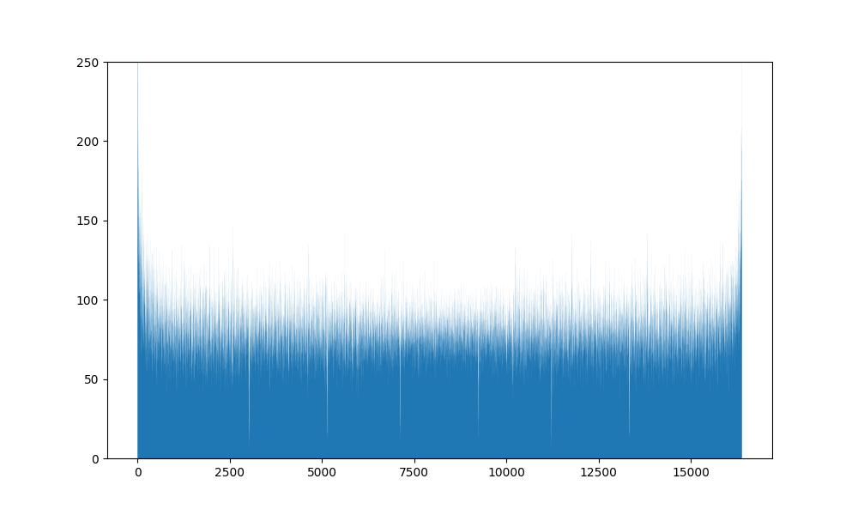
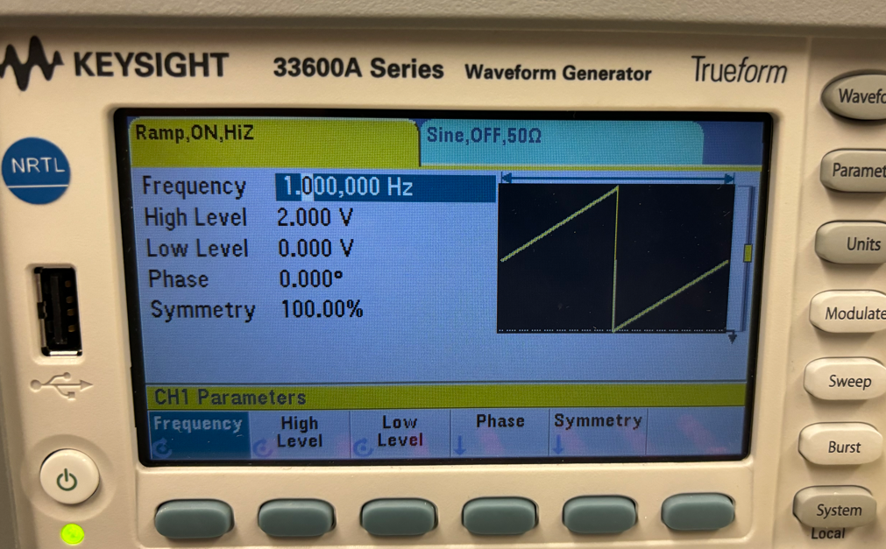
Histogram – INL/DNL
Sweep voltage across entire range of ColdADC
Looking for INL/DNL, missing codes
Want ~100 samples/code → ≥1,638,400 continuous samples (about 1 second)
Sweep with a ramp (or a sine wave) from external waveform generator
Sampling rate of 2MHz & 100 samples/code → sweep period of 1 second
Read out ColdADC data
Count # of samples per code per channel
Normalization → INL/DNL
(ongoing)
Single channel, ADC uncalibrated
Counts per code
ColdADC code

Slide 8
Why modify WIB firmware?
Linearity test (slow ramp) requires 1,638,400 continuous samples
Spy buffer has ~2000 sample limit per channel
Speed up averager test
Non-firmware implementation would require minimum 1024 spy buffer acquisitions

Slide 9
How to access data besides the spy buffer?
In the firmware, the COLDATA frame decoders extracts channel data and sends them in parallel to the DAQ frame builders, which validate the data and build a WIB frame around them to store in the spy buffers.
The frame builders perform a crucial step in validating & aligning the data so that each sample is only counted once and garbage data isn’t counted.
COLDATA Frame Decoders x16
metadata
DAQ Frame Builders x8
But how to access live data & validate the data without modifying existing firmware modules?
COLDATA
frames
data
DAQ
frames
Notes:
Condense to bullet points?

Slide 10
Modified frame builder to access raw streaming data
frame_builder
Validate and align data
Build WIB frame
deframed_data
deframed_data_aligned
WIB frame
data aligned flag
frame_builder_modified
Solution: Create a copy of the DAQ frame builder modules which validate & align the data and then send the data out to our new firmware modules.
copied
Notes:
Not a lot actually to fbld_modified – the data is already extracted from the COLDATA frame, and all we need it to do is validate and align data

Slide 11
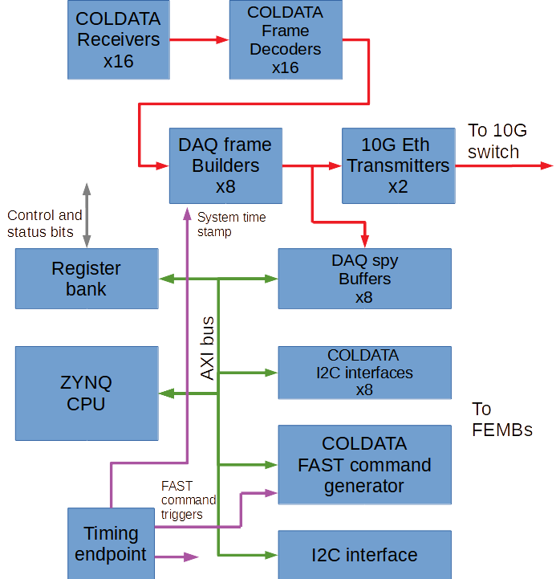
Firmware additions
Accumulators
x8
DAQ modified frame builders
x8
Histogram
Live data peek reg.
AXI BRAM controller

Slide 12
Accumulator (Averager) firmware module
Set DAT DAC to a value
fbld_modified
Accumulators x 8
Totals ready
Let ADC samples accumulate
deframed_data_aligned
state machine x 8
total_out
Registers
(x 64 indiv. accumulators)
rq_state x 8
User controls:
Trigger
Number of samples to take (max 262,144)
Software reads out totals
(indicates data is verified & ready)
Divide totals by # of samples to get average
For simplicity and flexibility in the number of samples that can be specified, the firmware only accumulates samples into totals and leaves it to software to divide them into proper averages.
Notes:
Totals are read out “indirectly” one by one by peeking and poking WIB registers –
Specify that registers are on AXI bus?

Slide 13
fbld_modified
Accumulators x 8
Totals ready
deframed_data_aligned
state machine x 8
total_out
(x 64 indiv. accumulators)
rq_state x 8
User controls:
Trigger
Number of samples to take (max 262,144)
(indicates data is verified & ready)

Slide 14
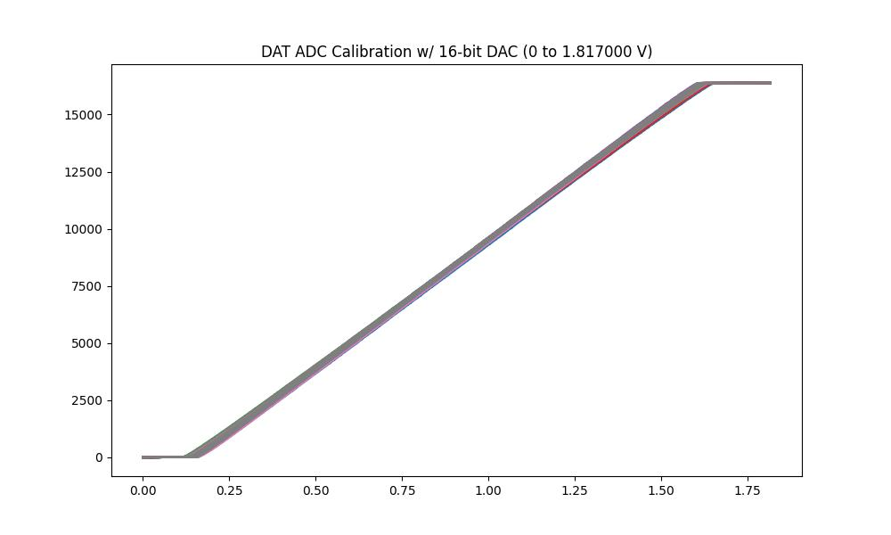
Accumulator results
128 channels’ data overlapped
ColdADC output (bits)
Further analysis is undergoing to extract some ADC performance metrics, such as DC offset, range of input, roll-back issue
DAT DAC input (V)
Notes:
To add: more detailed analysis? Graphs?

Slide 15
Histogram firmware module
Tell firmware we are analyzing a certain channel & trigger histogram
CHN0
CHN1
CHN2
Histogram STOP when required number of samples is reached
Histogram STOP when required number of samples is reached
Histogram STOP when required number of samples is reached
Let ADC code counts accumulate in memory
Send histogram CMD
Histogram START when ADC value is 0x0000
Histogram START when ADC value is 0x0000
Histogram START when ADC value is 0x0000
Time consumption of histogram study mainly depends on the period of ramp
Software block reads out code counts
Notes:
Note that only one channel at a time is analyzed because of memory allocation constraints (discussed later)

Slide 16
Histogram firmware module
fbld_modified
Channel data live monitoring
Histogram
Code counts ready
deframed_data_aligned
state machine
Code counts
Code count
BRAM memory
2^13 32-bit regs.
AXI bus
rq_state x 8
User controls:
Trigger
Number of samples to take (max 2^32)
Channel to analyze
(indicates data is verified & ready)
BRAM is AXI-mapped at 0xA00C8000 to 0xA00CFFFF
Notes:
Only enough mapped memory available to analyze one channel at a time, so their data is taken sequentially and not all at once
Everything except BRAM memory is via registers, BRAM is handled via a separate AXI BRAM controller mapped to memory in order to allow quicker readout

Slide 17
fbld_modified
Channel data live monitoring
Histogram
Code counts ready
deframed_data_aligned
state machine
Code counts
Code count
BRAM memory
2^13 32-bit regs.
rq_state x 8
User controls:
Trigger
Number of samples to take (max 2^32)
Channel to analyze
(indicates data is verified & ready)

Slide 18
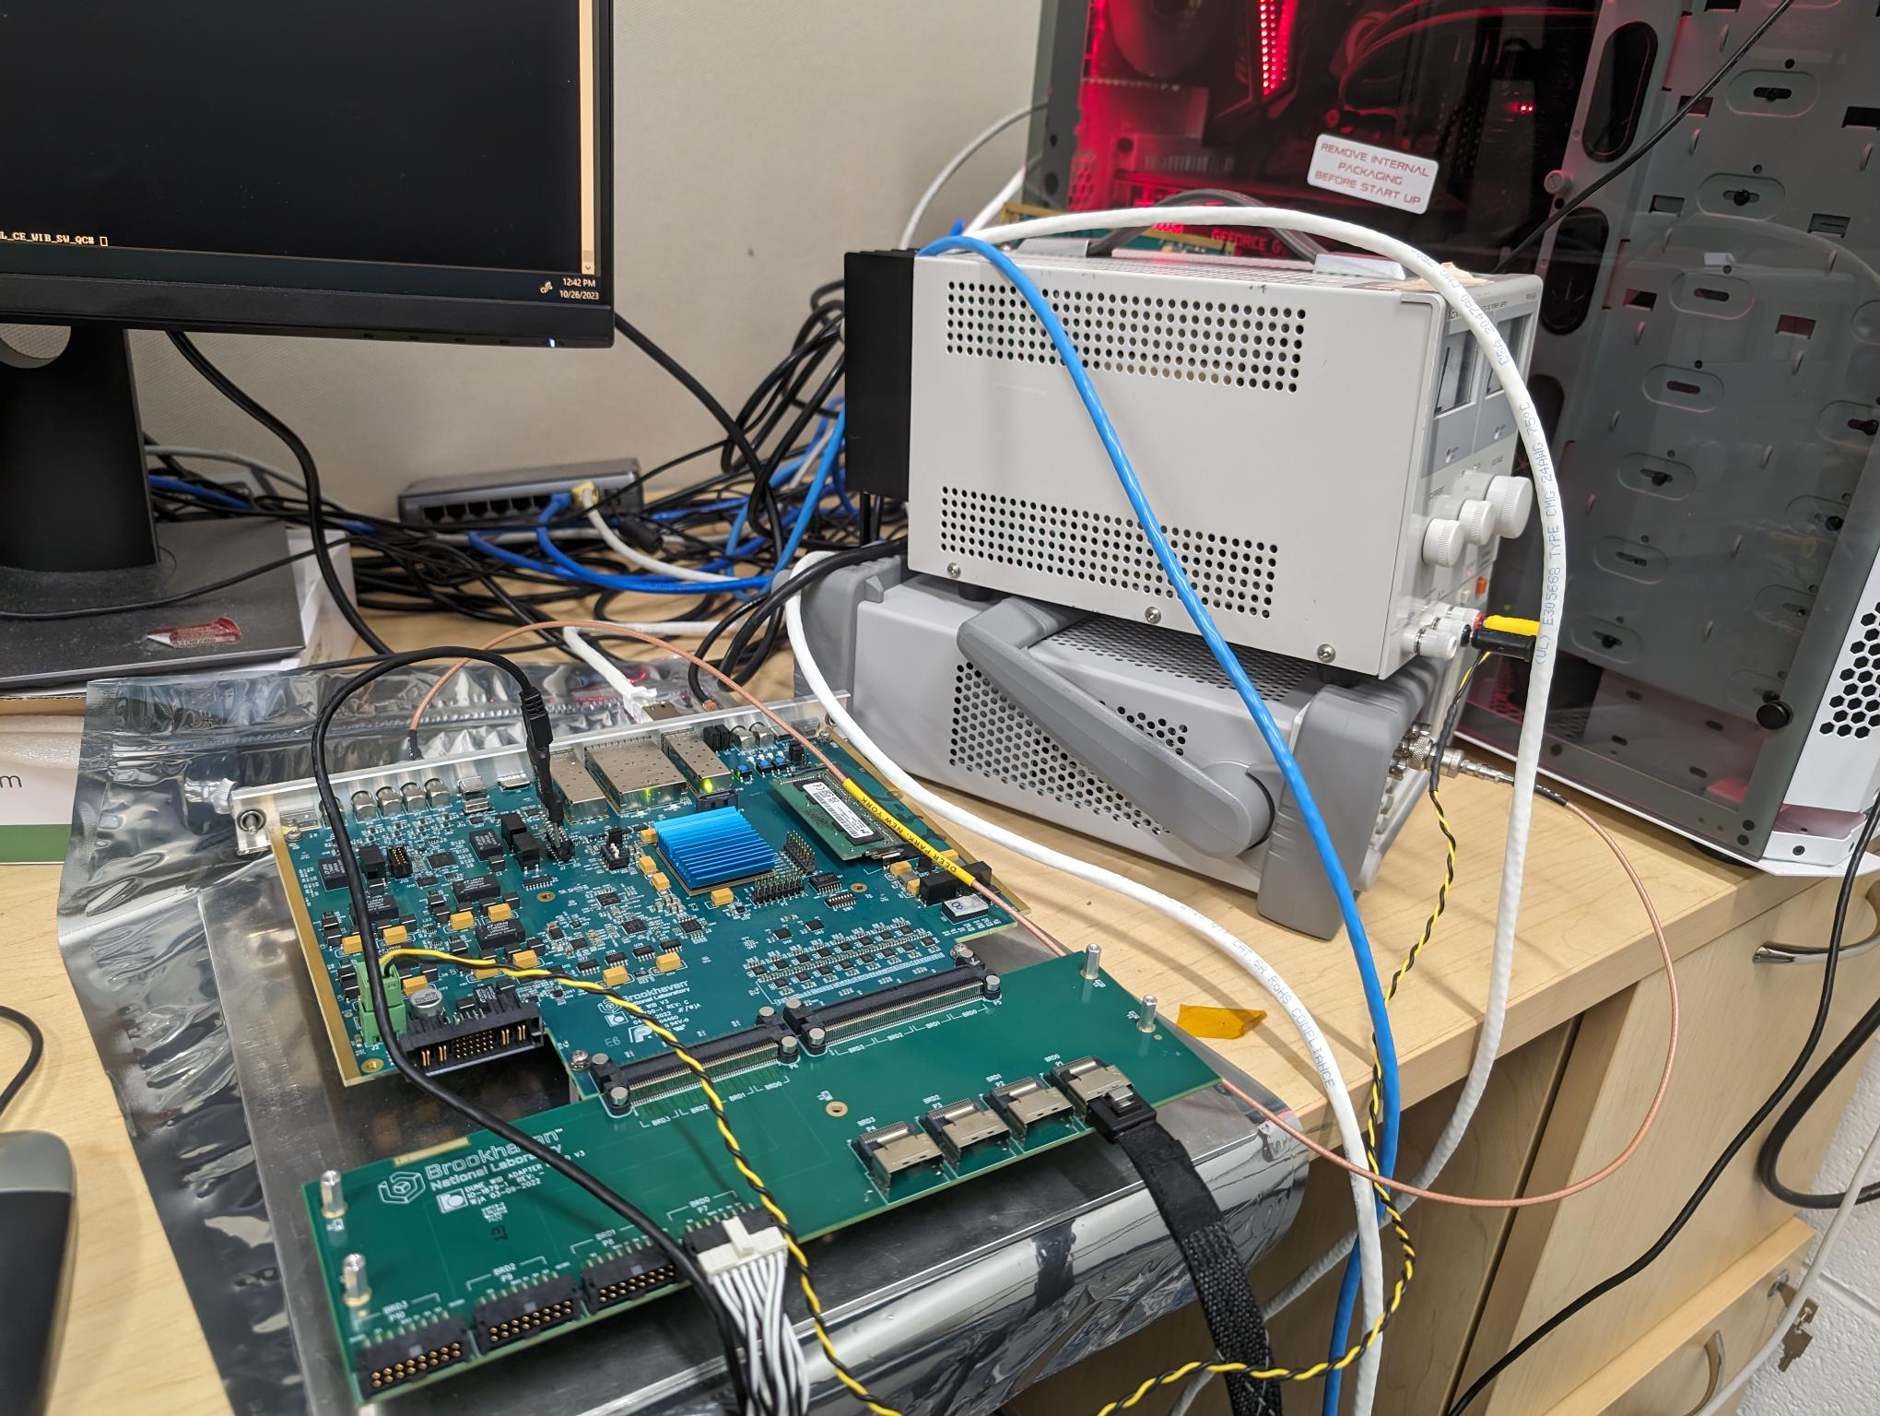
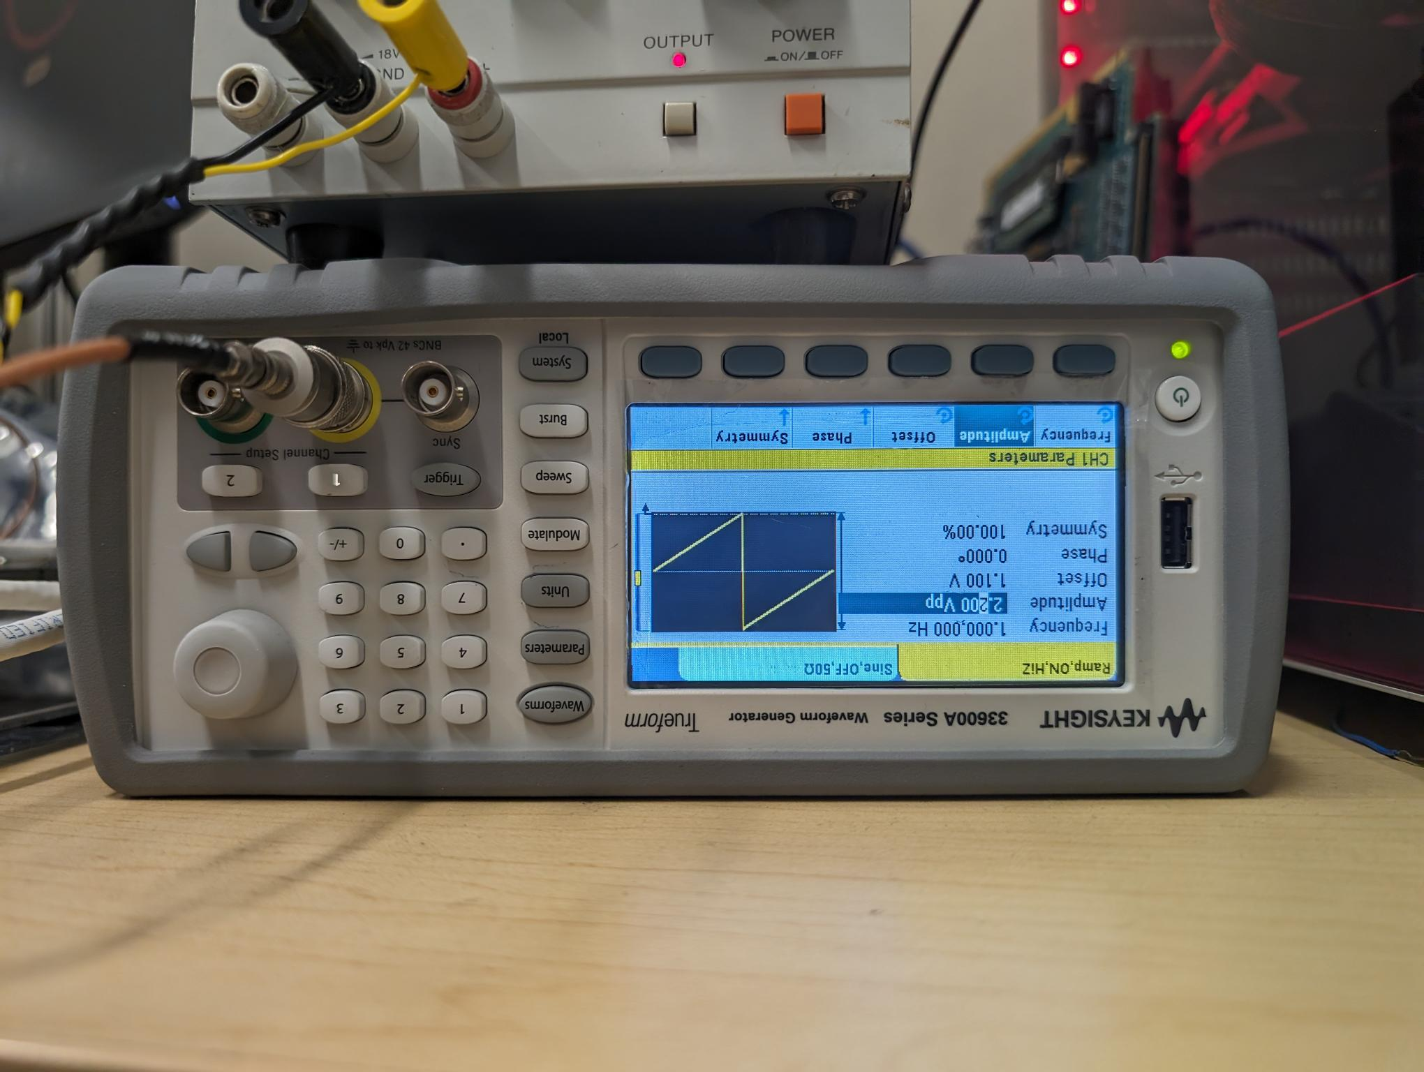
Histogram hardware setup
Need to be updated for the latest automatic trigger scheme
1. Connect a BNC-LEMO connector from one of the signal generator’s output channels to P8 on the WIB.
2. Configure a ramp waveform with a period of >1 second from a voltage below the ADCs’ range to above their range.
I am using a Keysight 33600A waveform generator.
Notes:
Amplitude depends on length of data cable, 2V may be adequate but 2.2V was needed for my setup

Slide 19
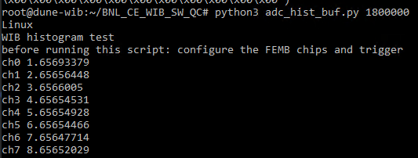
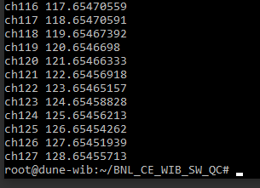
Realtime Histogram Testing and Analysis
Extra <1s need for find T0 for Ch0
CHN0
CHN1
CHN2
Histogram STOP when required number of sample is reached
Histogram STOP when required number of sample is reached
Histogram STOP when required number of sample is reached
The time consumption ONLY depends on the period of the RAMP.
Send histogram CMD
Histogram START when ADC value is 0x0000
Histogram START when ADC value is 0x0000
Histogram START when ADC value is 0x0000

Slide 20
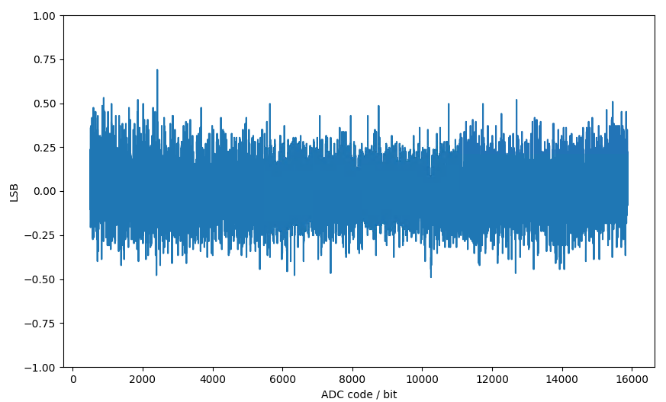
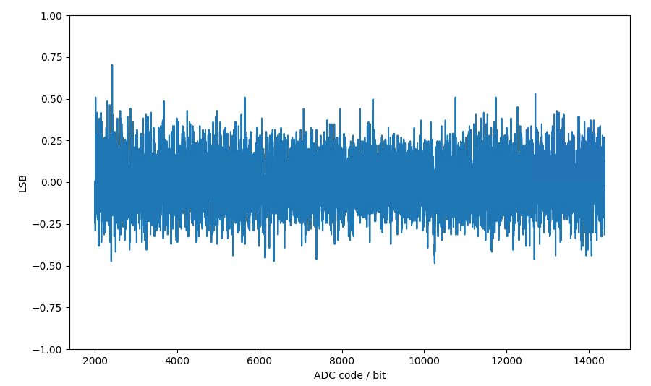
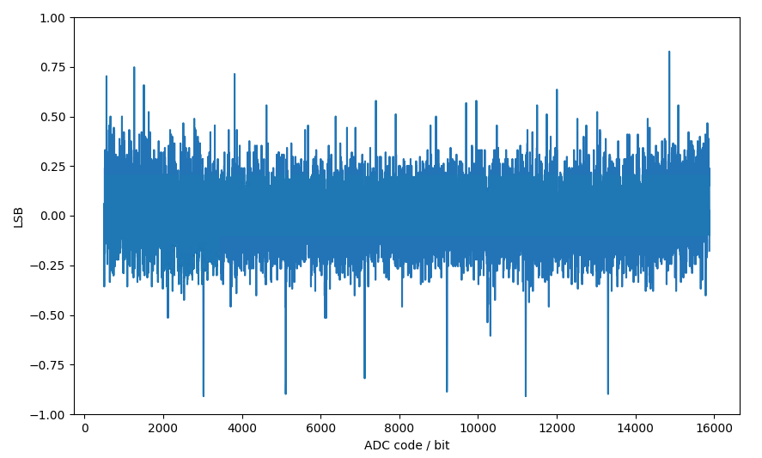
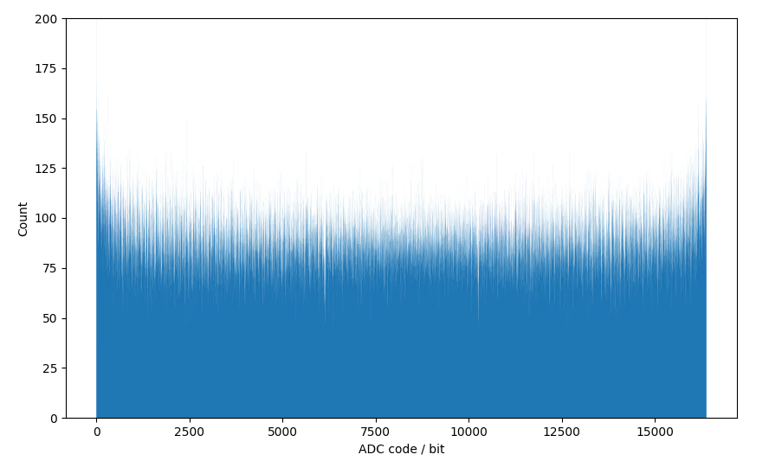
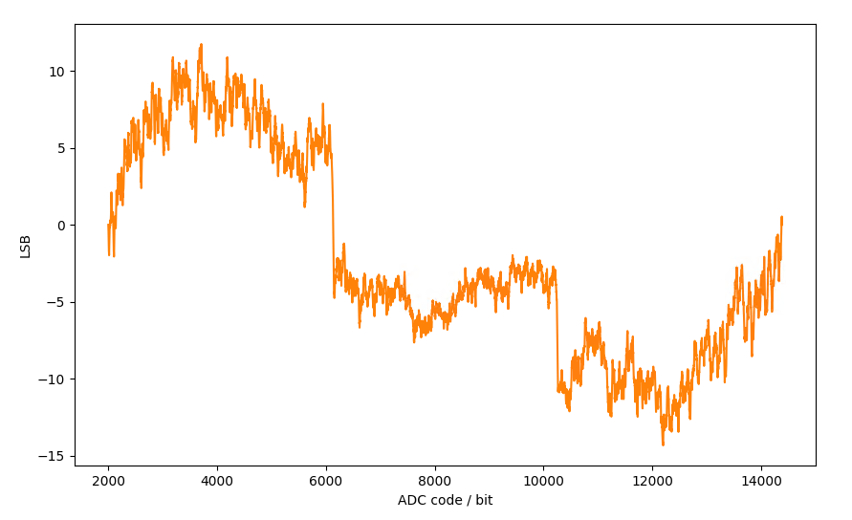
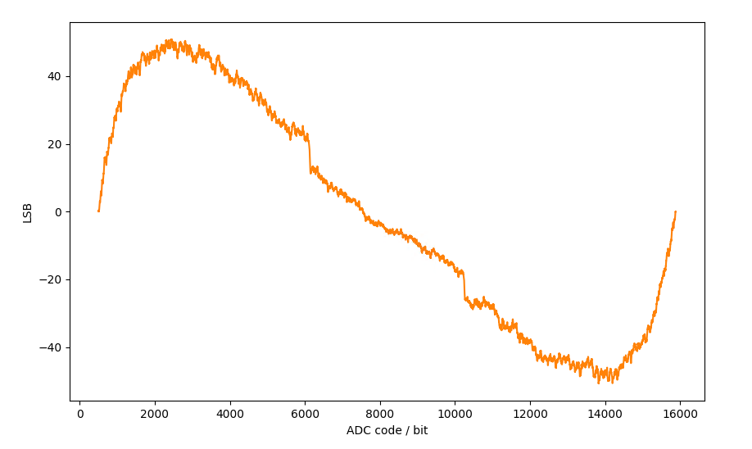
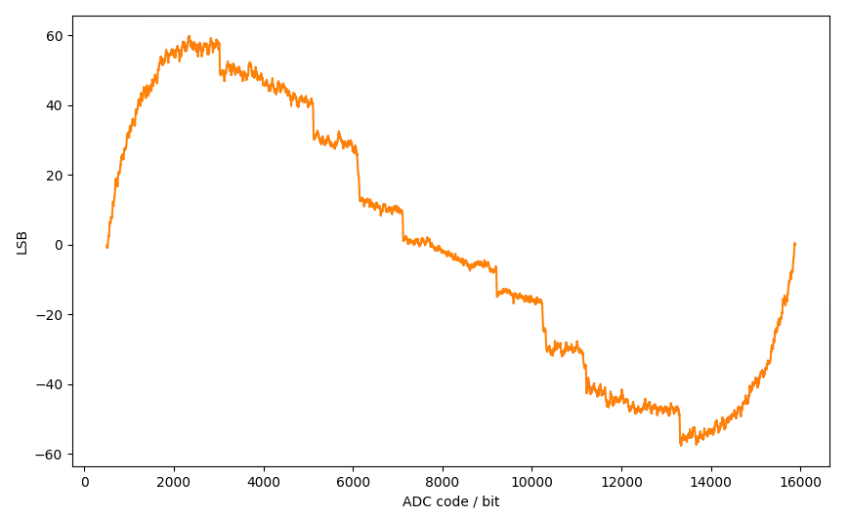
Normalization (Preliminary, ColdADC calibrated)
DNL of CH0
DNL of CH0
DNL of CH0
DNL of CH0
DNL of CH0
INL of CH0
INL of CH0
INL of CH0
INL of CH0
Histogram result of CH0
ADC code [2000,14384]
ADC code [500,15884]
ADC code [2000,14384]
ADC code [500,15884]
Note: Ramp signal is applied to all 128 channels simultaneously.

Slide 21
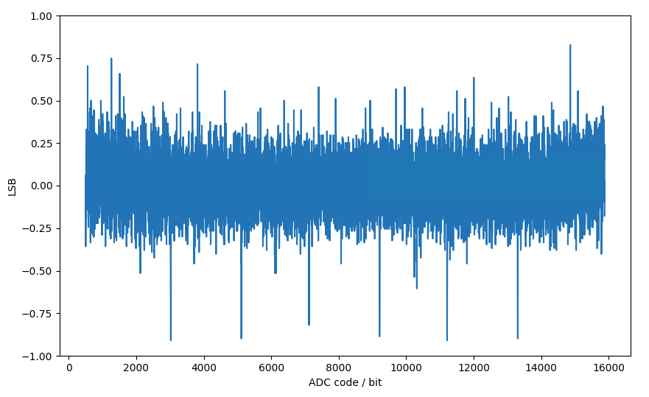
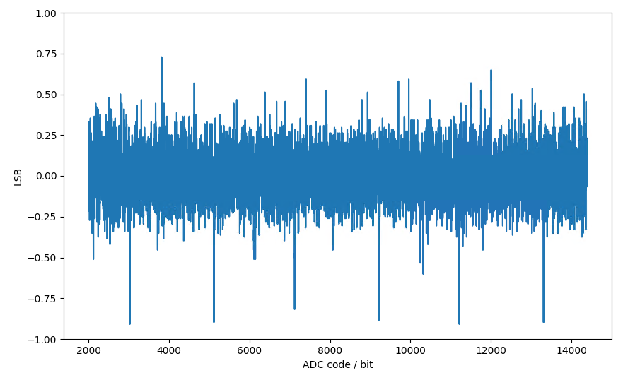
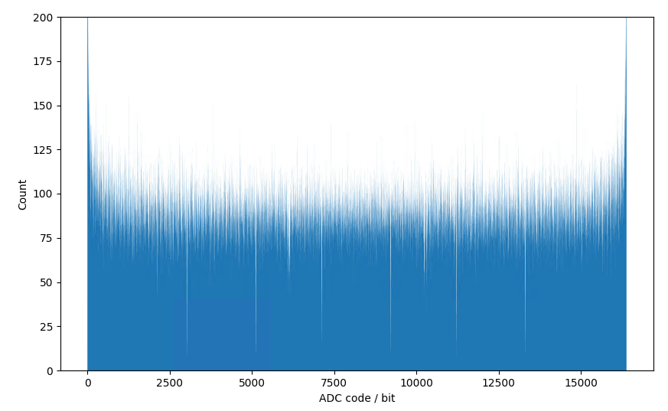
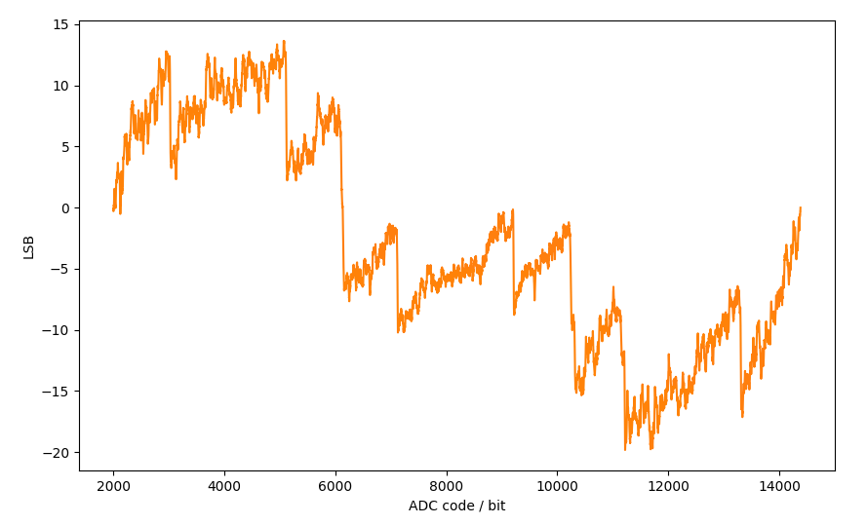
Normalization (Preliminary, ColdADC uncalibrated)
DNL of CH0
DNL of CH0
INL of CH0
INL of CH0
Histogram result of CH0
ADC code [500,15884]
ADC code [2000,14384]
Note: Ramp signal is applied to all 128 channels simultaneously.

Slide 22
WIB registers used – config register bank
0xA00C0078: Histogram channel to analyze, lemo_io_0 output selector
0xA00C007C: Histogram # samples
Address, hex | Bits in register | Parameter name | Description
0xA00C0070 | 28:10 | accum_num_samples | Number of samples to accumulate
0xA00C0070 | 9:1 | accum_total_ch_sel | Accumulator channel readout selector. Channel X's accumulated total will appear in the register accum_ch_total if you write X to this register.
0xA00C0070 | 0 | accum_trig | Triggers accumulators to begin
0xA00C0074 | 0 | hist_trig | Triggers histogram to begin
0xA00C0078 | 8:0 | hist_ch | Channel to take histogram data for
0xA00C007C | 31:0 | hist_num_samples | Number of samples to count for histogram
Latest production firmware uses config registers up to 0xA00C0044
Notes:
Can be changed if needed (secondary register bank to minimize use of main registers, could bring it down to 2ish registers (one config and one status)?)

Slide 23
WIB registers used – status register bank
Address, hex | Bits in register | Parameter name | Description
0xA00C00F0 | 23:10 | deframed_data_mon | Allows software to “peek” into the live channel data to aid the histogram test (hist_ch determines which channel)
0xA00C00F0 | 9 | hist_ready | Indicates that the histogram has finished taking samples
0xA00C00F0 | 7:0 | accum_ready | Bit Z indicates that accumulator Z (connected to COLDATA Z) has finished taking samples
0xA00C00F4 | 31:0 | accum_ch_total | Displays the total accumulated in channel accum_total_ch_sel when its accumulator is finished
0xA00C00F8 | 31:0 | hist_out | Was used for peek-by-peek readout of histogram data, but no longer used.
Latest production firmware uses status registers up to 0xA00C00D8
Notes:
Can be changed if needed (secondary register bank to minimize use of main registers, could bring it down to 2ish registers (one config and one status)?)

Slide 24
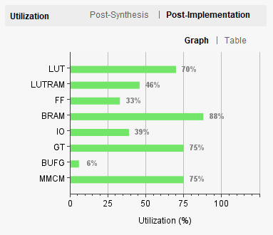
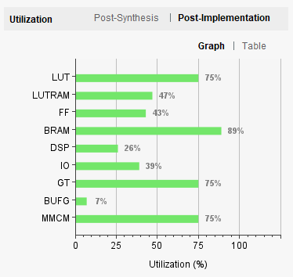
Resource utilization increase
Production firmware:
This firmware:
(+5%)
(+1%)
(+10%)
(+1%)
(+26%)
(+1%)
Includes the addition of the modified frame builder, the accumulator, and the histogram.

Slide 25
To-do list
1. Histogram study with a sine waveform instead of a ramp
2. ENOB study
3. Develop analysis scripts for ADC static performance metrics
DC-offset, input range, gain, DNL/INL, overflow protection, and etc.
4. Organize a QC procedure – scripts, database, etc.
Notes:
ENOB technically optional?

Slide 26
Summary
Histogram development & study with a slow ramp signal is done
DAT board has been deemed capable for ColdADC QC
All necessary QC items have been verified
New DAT revision will inject test pulse to each channel independently

Slide 29
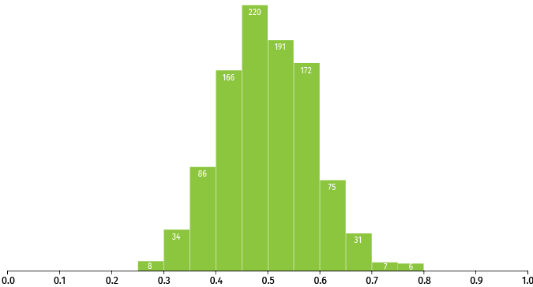
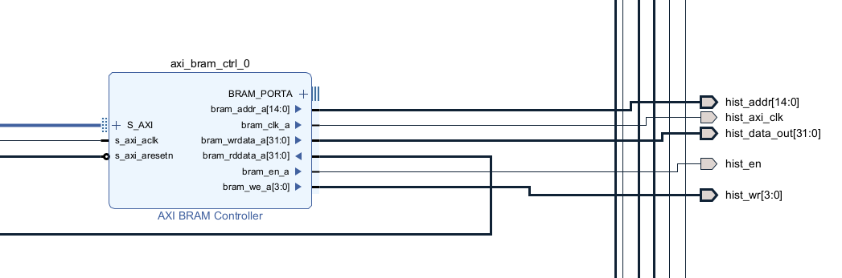
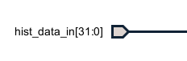
AXI memory mapping
To speed up readout of histogram data, I implemented a AXI BRAM controller in the firmware’s block design that accesses one side of the histogram dual-port block memory
histogram data
Port A
Histogram BRAM
Port B
Linux
AXI BRAM controller RO
AXI bus
Histogram
Direct R/W
2^14 x 16 bits = 32 KB BRAM
“Port B”
Notes:
Don’t need to explain in detail
AXI BRAM/Petalinux side CAN write, useful for debugging purposes, but it doesn’t need to in this application

Slide 30
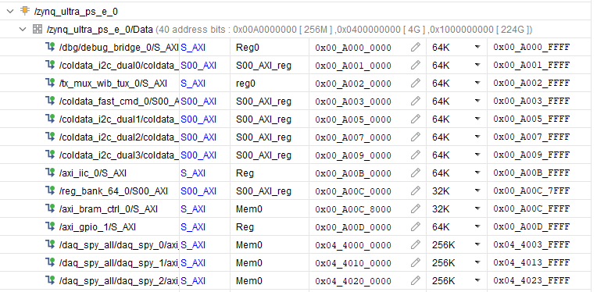
AXI memory mapping
Notes:
Reg_bank_64 originally spanned memory from A00C0000 until A00D0000. Reg_bank_64 uses only 128 bytes total of its 64KB allocated memory, so I decreased that allocation to 32K and squeezed in the AXI BRAM controller at A00C8000.
I couldn’t just squeeze it in between spy buffers because the kernel has to know that the memory is mapped to something, the spy buffers use all of their allocated space, and I didn’t want to have to change the kernel. This is also the reason I can only read out 1 channel at a time

Slide 31
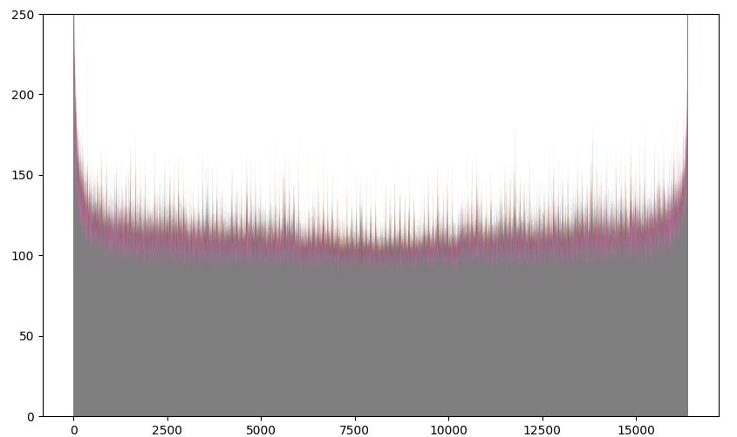
Histogram results
ColdADC code counts
1 second ramp from 0 to 2.2V, 1,639,000 samples/channel
Counts per code
ColdADC code
Notes:
To add: more detailed analysis?

Slide 32
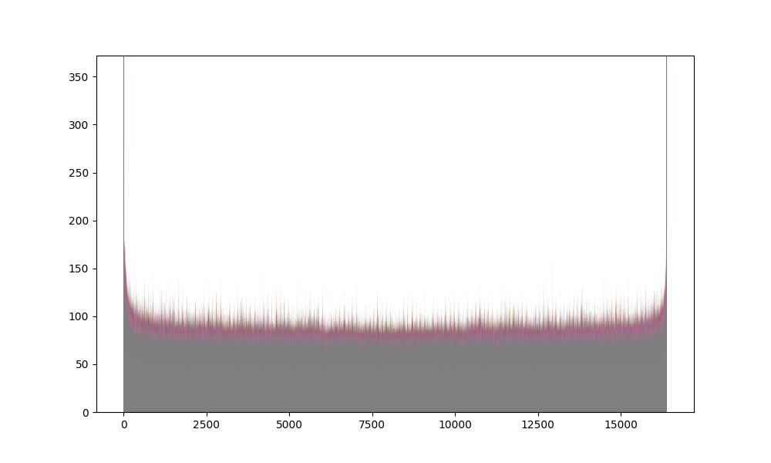
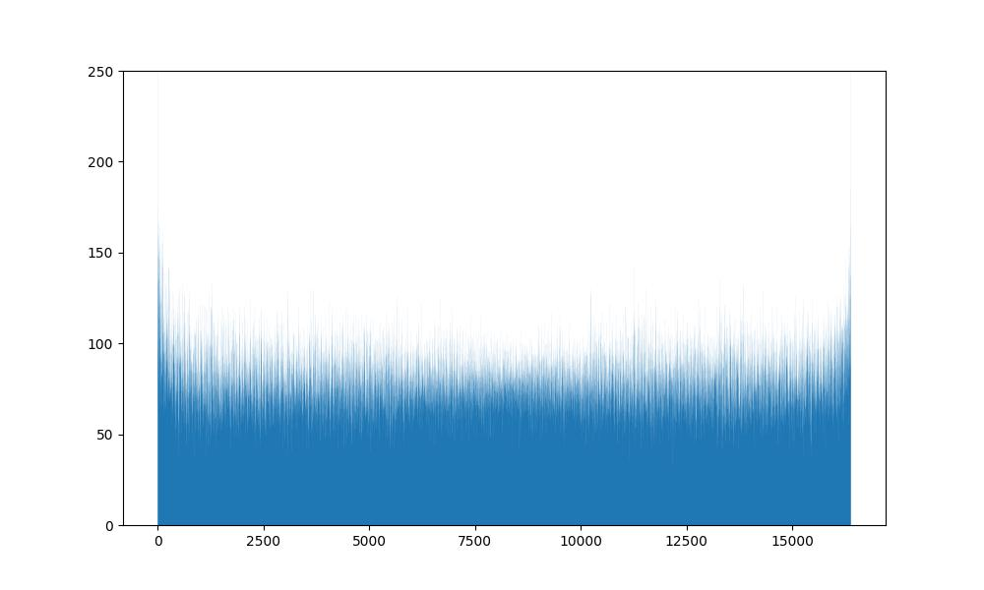
Histogram results
ColdADC code counts
1 second ramp from 0 to 2.2V, 1,639,000 samples/channel
Single channel, uncalibrated
Single channel, calibrated
One plot of a channel when ADC is calibrated
Counts per code
One plot of a channel when ADC is uncalibrated
Counts per code
ColdADC code
ColdADC code
Further analysis is undergoing to extract some ADC DNL/INL
Notes:
Missing codes should show up in uncalibrated

Slide 33
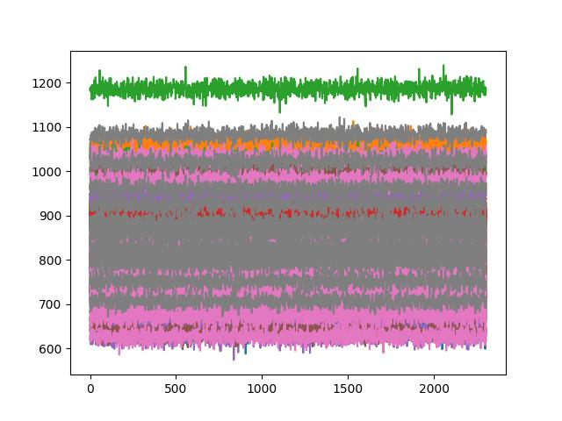
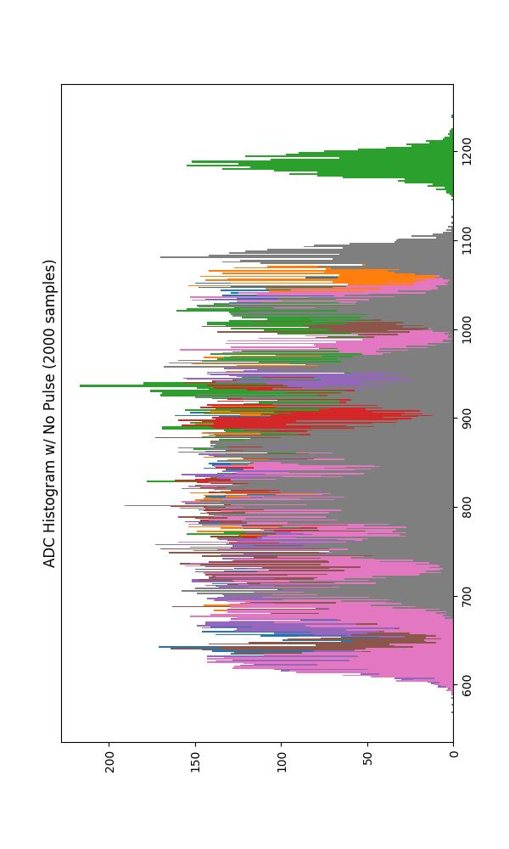
Spy buffer vs. histogram comparison
ColdADC Readout w/ No Pulse
Notes:
Early proof-of-concept histogram graphs (mostly just a fun demonstration)

Slide 34
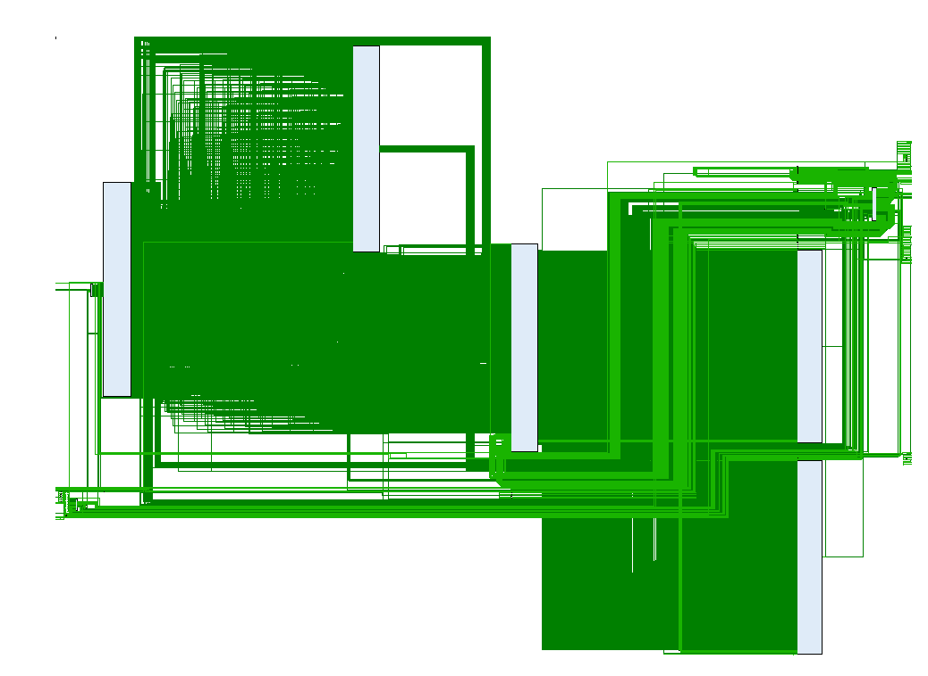
Backup slide: Vivado firmware schematic
fbld
Zynq
deframer
modified fbld
accumulator
histogram

Slide 35
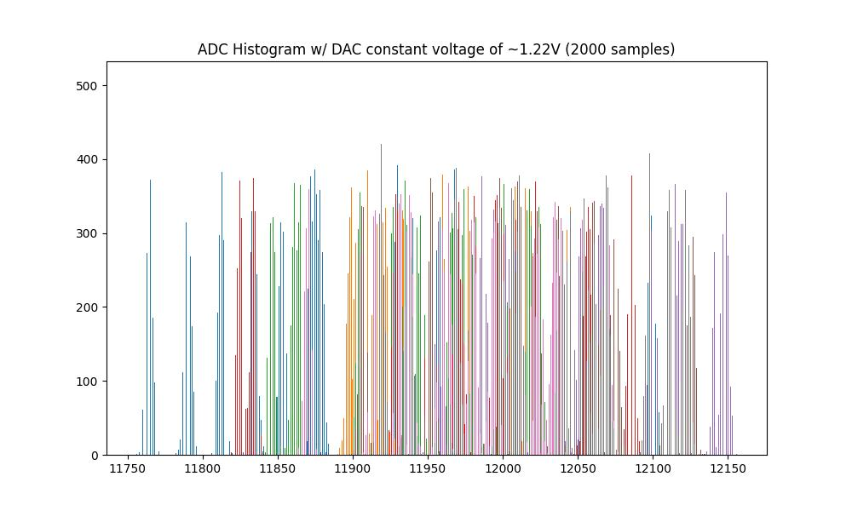

Slide 36
Accumulator software (still in development)
Procedure:
Set DAT registers so that ADC channels are connected to the ADC DAC
Set DAC to 0 LSB
Set number of samples to take
Trigger the accumulators
When accumulators finished, read channel totals out one by one
Set DAC to 1 LSB
…etc.
Command line:
root@dune-wib:~/BNL_CE_WIB_SW_QC# python3 adc_dac_cal.py
python3 adc_dac_plot.py tmp_data/ADCcal_02_10_2021_06_19_06.bin
Notes:
Channel X total will appear in the totals register if you write X to a certain other register

Slide 37
Histogram software (still in development)
Procedure (after hardware setup):
Set WIB register so that P8 LEMO input is sent over data cable to the DAT
Set DAT registers so that ADC channels are connected to WIB external signal
Set channel_to_analyze to 0
Wait until live channel monitor register equals 0x0000
Trigger histogram
When histogram indicates it’s finished, copy the histogram block of memory
Set channel_to_analyze to 1
…etc.
Save the copied data to a .bin file or similar
Command line:
root@dune-wib:~/BNL_CE_WIB_SW_QC# python3 adc_hist.py 1639000
python3 adc_hist_plot.py tmp_data/ADChist_22_09_2021_06_02_19.bin
Notes:
The way the histogram data is copied is the same way that the spy buffer data is copied (memcpy)
This greatly speeds up execution time compared to peek/poking one by one
Will go into how I implemented this later

Slide 38
Faster spy buffer decoding using DUNEDAQ C++ software
Initial WIB Ethernet (HERMES) frame decoding was done with Python (very slow)
Downloaded source code necessary for decoding frames to WIB
Compiled .so library file for WIB
Wrote script for generating a Windows or Linux library file for off-WIB analysis
Sped up decoding time of one frame from a few seconds to instantaneous
Notes:
What is the exact speedup figure?

